Slide 1
How to revise for your politics exam?
Jal Patel - Head of Politics Editor
alevelpolitics.com
Twitter - @patelshop
alevelpolitics.substack.com

Slide 2
What we plan to cover today?
Who is this webinar for?
What most students are currently doing? (bad revision)
How to maximise your revision through essay writing?
How to schedule a realistic timetable?

Slide 3
Who is this webinar for?
This webinar is for all year 13 politics students, no matter where you think you are with your revision
Whether you feel you are on top of revision but now want to tweak your final week or whether you feel you are floundering
What I am about to say may save you your A level
Every year at this time I tell my students, bluntly, what they are doing wrong
Some listen, some don’t
I also find that many teachers fail to fully explain how to revise
And students just carry through GCSE revision strategies, hoping these will work at A Level
Worse still, too many students fail to really get ‘into revision’ until they feel the pressure of time or when they go on study leave
By then, there are too many subjects to juggle and they end up focusing on one exam at a time

Slide 4
What you told me,
how do I revise?
I don't really revise - I try to remember any facts/information and might make really scrappy plans
Blurting, Recording myself, essay plans
Writing notes, making flashcards, making essay plans.
Mind maps, essays
Taking notes from a revision guide
flash cards, pomodoro technique, mind map, documentaries
Planning potential essays
Summarising my notes in flashcards and writing essay plans
Mind maps, quizlet, pass paper questions
Summarising notes in flashcards
mind maps, flash cards, looking over exam questions - none of this feels effective though as i feel like i never got an in-depth understanding through classes, it was very surface level - so i’m still trying to catch up.
I usually revise off the textbook
Just go over my notes and re read everything
Writing notes and reading over them a lot and highlighting
Watching videos. Looking through notes.
Essay plans, flash cards, some full essays but I find this hard as l need extra time and struggle to find the time to write essays whilst I am still in college
Making detailed notes then planning exam questions and memorising them then writing them out in full exam conditions and peer marking them

Slide 5
Approaches to revision
High intensity
Writing essays in full from a list of potential questions
Detailed essay plans
Reading over your essays out loud and amending and rewriting these essays
Teaching others what you have learnt
Medium intensity
Learning from exemplar essays (my site) and examiners reports
Preparing examples to use in each topic and memorising them
Pairing up with other students and talking through essays and how to answer
Generally planning past papers
Watching documentaries for examples (passive)
Low intensity
Taking notes from the text book
Rewriting your notes
Condensing your notes
Highlighting your notes/textbook
Reading your text book

Slide 6
So…
You are not revising if you are not practicing essay questions
The more you engage in low level or only medium intensity activities the less prepared you are for your exam
You have to change the way you revise
But sir! What if I do not have enough knowledge?
Your essay writing is ‘targeting’ your revision.
By focusing on an essay you are ‘taking notes’ paragraph by paragraph.
Your notes are your essays
Don’t delay in writing essays because you think you haven’t read enough of the text book - use the text book to help you with knowledge, analysis and examples when actively writing essays
Give yourself 3 hours, for example, for politics essay writing - smaller more intense sessions are more productive than longer sessions.
You should be timetabling each day (example to come) by specifying essays you will be working on, not general topics
Tackle the most challenging essays and produce detailed plans of those essays you cannot write (an example later)
Before your exams you should have a folder full of essays and detailed plans that you use from which to revise

Slide 7
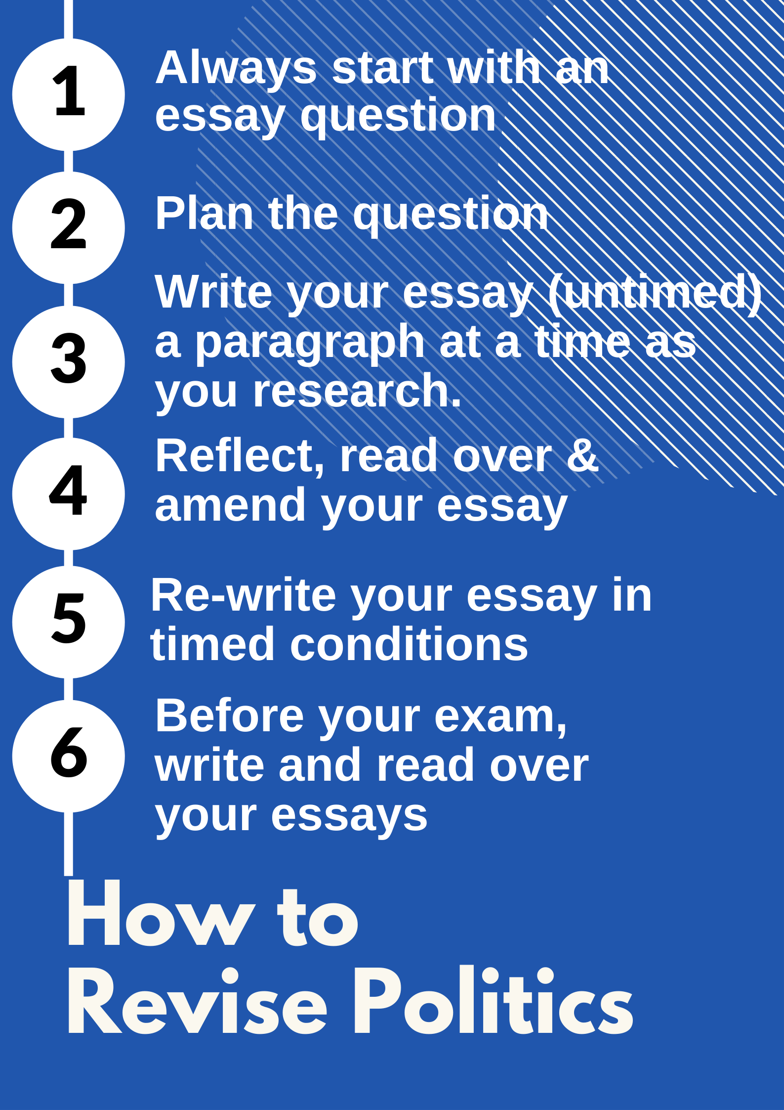

Slide 8
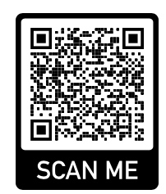
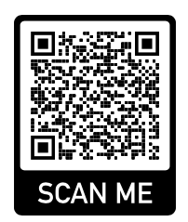
How do you schedule your
revision?
At this stage you should be maximising your days to write essays
If you are not on study leave yet and do not find lessons productive then ask to go to the school library
Always work in a quiet space, your phone should be away from you
Give yourself 2 - 3 hours per day per lesson (2 hours on Uk and 1 hour on ideas)
Schedule each challenging essay or essay plan in advance
I have provided the majority of potential questions based on the advance information Edexcel AQA
I have also planned (since February) many of these potential questions in my webinars

Slide 9
How to make a timetable
 | Monday | Tuesday | Wednesday | Thursday | Friday
10-1 | Politics Democracy Rights Essay
2-4 | History
5-8 | English
Only dedicate a maximum of 3 hours per subject
Try to make sure you specify in advance what
essay you will be working on
Keep all distractions away
Use your one hour break in between to relax

Slide 10
Day/Week | UK Essay Questions - 2 hours per day | Corresponding webinar lesson
3 May | Evaluate the view that we can no longer be assured that rights are protected adequately in the UK | Series 1 - lesson 1
4 May | Evaluate the view that pressure groups are less influential than corporations in influencing government policy | Series 1 - lesson 2
5 May | Evaluate the view that those pressure groups that have abundant resources have the greatest influence on government policies | Series 1 - lesson 2
6 May | Plan remaining democracy questions | See potential questions
7 May | Evaluate the view that the major political parties disagree on policies and ideas | Series 1 - lesson 3
8 May | Evaluate the view that the Conservative Party is internally divided / polarised | Series 1 - lesson 4
9 May | Evaluate the view that the Labour Party is internally divided / polarised | Series 1 - lesson 4
10 May | Evaluate the view that the current Conservative party is a Thatcherite party | Series 1 - lesson 4
11 May | Evaluate the view that the current Labour party have moved away from New Labour / Old Labour | See my website essays
12 May | Evaluate the view that the Westminster electoral system is in urgent need of reform | Series 2 - lesson 1
13 May | Evaluate the view that apart from FPTP the various electoral systems in use in the UK have helped to broaden party representation and voter choice and participation | Series 2 - lesson 2
14 May | Politics Revision Day London and Online!
15 May | Evaluate the view that the media have a decisive impact on the outcome of elections | Series 2 - lesson 2
16 May | Evaluate the view that a codified constitution is now overdue | Series 2 - lesson 3
17 May | Evaluate the view that there are more advantages to having a codified and entrenched constitution than remaining with an uncodified constitution | Series 2 - lesson 4
18 May | Evaluate the view that the need for further English devolution is now overdue | Series 2 - lesson 4
19 May | Plan other constitution questions | See potential questions
20 May | Evaluate the view that backbenchers have little impact on parliament | Series 3 - lesson 1

Slide 11
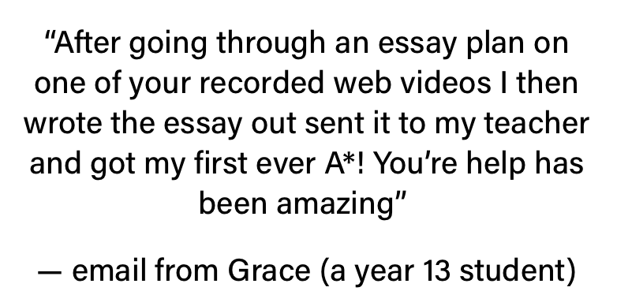
Day/Week | Essay Question | Corresponding webinar lesson
21 May | Evaluate the view that executive dominance ensures parliament has little meaningful control over the legislative process | Series 3 - lesson 2
22-25 May | Consolidate Component 1 (see slide on consolidation)
26 May | Evaluate the view that the conventions on ministerial responsibility no longer apply in practice | Series 3 - lesson 3
27 May | Evaluate the view that the UK Supreme Court is effective at checking on the power of government / Neutrality and independence | Series 2 - lesson 4
29 - 30 May | Consolidate C2
30-17 | Work on USA/Global revision (please note you will have to revise for these earlier - so maybe so an additional few hours in a week but you do have 18 days to revise C3) | See my global 2 series
Day/Week | Political ideas (1 hour per day) | Corresponding webinar lesson
W/b 3 May | Do Conservatism | See my current webinars
W/b 16 May | Do Socialism | See webinars starting this Friday
Wb 23 May | Do Non-core idea | See feminism/multiculturalism webinars

Slide 12
How to consolidate?
Before your exams you should have a folder full of essays and plans
Consolidation means to remember as much of this content as possible
This can be achieved through the following:
Reading over your essays - out loud and over again
Re writing key essays in timed conditions to see how much you can remember
Reading out essays to your politics partner reading over their essays
If you cannot remember parts of an essay - re write those again
The more you write and read the more you will remember - this is active recall
At this stage you can also write a crib sheet of examples
I will probably do a webinar reminding you of examples just before the exam but i have dedicated the entire morning of my revision day to focus on webinars

